Slide 1
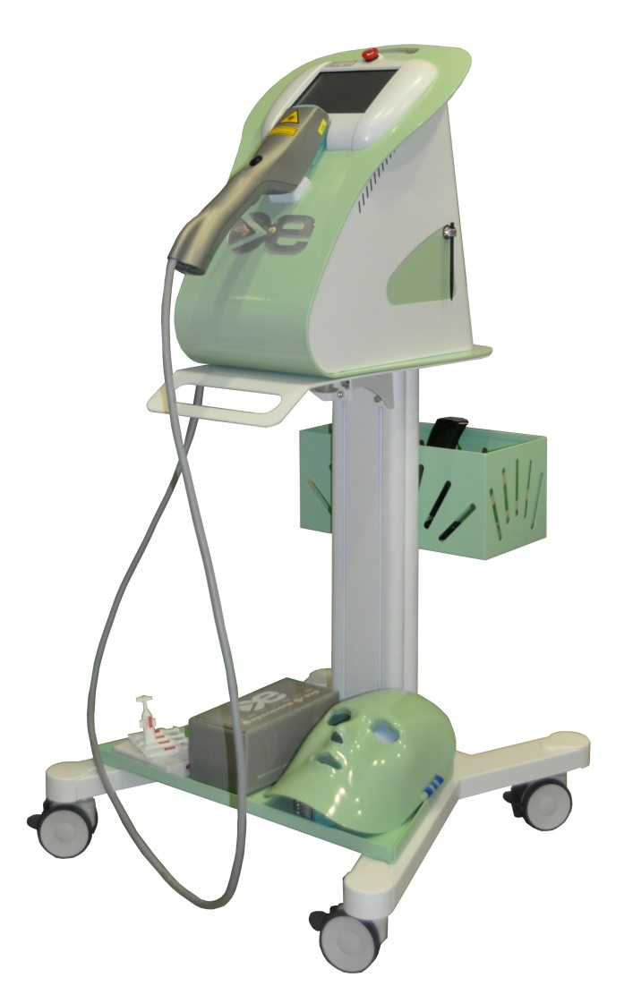
CONFIDENTIAL – ONLY FOR INTERNAL USE
NEW OPPORTUNITIES
WITH EYE-LIGHT®
POST-BLEPHAROPLASTY
DEMODEX
BLEPHARITIS
CHALAZION
STYE
245 REV01 ENG - NEW OPPORTUNITIES WITH EYE-LIGHT 04 2019
TREATMENTS INDICATIONS ARE SUBJECTED TO LOCAL LAWS RESTRICTIONS

Slide 2
CONFIDENTIAL – ONLY FOR INTERNAL USE
POST-BLEPHAROPLASTY
TREATMENTS INDICATIONS ARE SUBJECTED TO LOCAL LAWS RESTRICTIONS

Slide 3
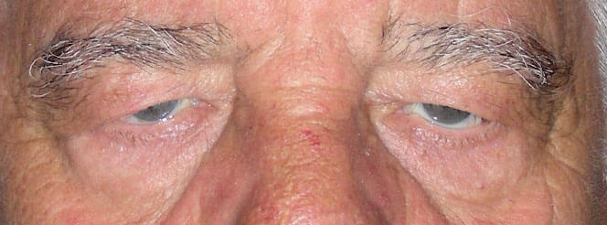
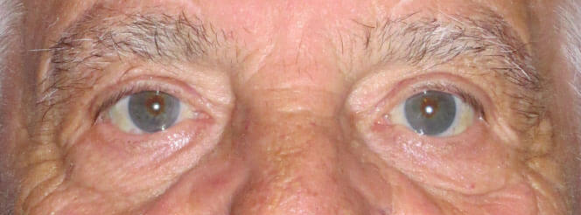
CONFIDENTIAL – ONLY FOR INTERNAL USE
WHAT IS BLEPHAROPLASTY?
AESTHETIC SURGERY PROCEDURE FOR THE CORRECTION OF EYELIDS ALTERATION
BEFORE
AFTER
THE TARGET IS TO REMOVE CUTANEOUS AND ADIPOSE EXCESS FROM LOWER AND/OR UPPER EYELID
EVERY YEAR THOUSANDS OF THESE OPERATIONS ARE PERFORMED, IMPROVING PATIENT’S PERCEPTION OF ONE’S IMAGE AND CONSEQUENTLY ONE’S SELF-ESTEEM
TREATMENTS INDICATIONS ARE SUBJECTED TO LOCAL LAWS RESTRICTIONS

Slide 4
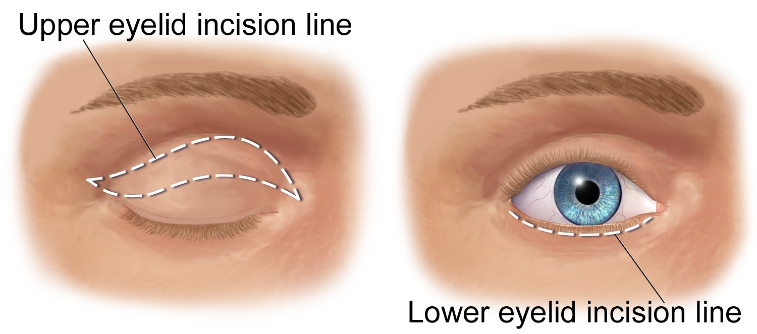
CONFIDENTIAL – ONLY FOR INTERNAL USE
WHAT IS BLEPHAROPLASTY?
THE SURGERY
THE LOWER, UPPER OR BOTH EYELIDS CAN BE CORRECTED BY BLEPHAROPLASTY THE INCISIONS ON THE UPPER EYELID FORM A KIND OF ELLIPSE WITH A VERTEX CLOSE TO THE INNER CORNER OF THE EYE AND THE OTHER A FEW MILLIMETERS BEYOND THE OUTER CORNER
TREATMENTS INDOCATIONS ARE SUBJECTED TO LOCAL LAWS RESTRICTIONS

Slide 5
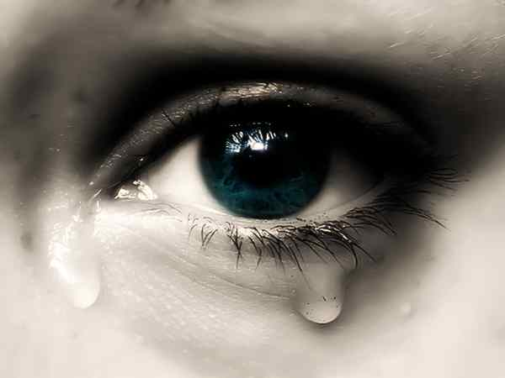
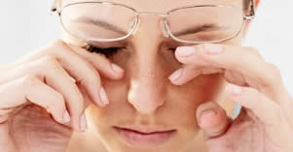
CONFIDENTIAL – ONLY FOR INTERNAL USE
AFTER SURGERY COMPLICATIONS
EYE WATERING, ITCHING AND BURNING ARE COMMON SYMPTOMS AFTER BLEPHAROPLASTY, AS WELL AS EYELID SWELLING. A FURTHER COMPLICATION CAN BE AN ANOMALOUS SCARRING.
TREATMENTS INDICATIONS ARE SUBJECTED TO LOCAL LAWS RESTRICTIONS

Slide 6
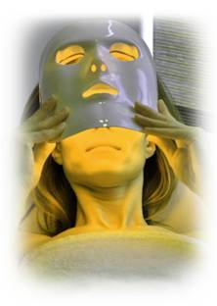
CONFIDENTIAL – ONLY FOR INTERNAL USE
TREATMENT
IT CONSISTS OF A PHASE 1 (WITH A SPECIFIC YELLOW LIGHT MASK)
AND A PHASE 2 (WITH THE STANDARD SUPPLIED RED LIGHT MASK)
PHASE 1 – YELLOW MASK
Yellow light has a specific action on the lymphatic system and stimulating cell metabolism promotes a detoxifying action to alleviate swelling and post-intervention oedema
PHASE 2 – RED MASK →
Red light accelerates and optimizes the eyelid surgical wound healing process by stimulating the production of collagen and elastin: it is absorbed by mitochondria and stimulates ATP by increasing and improving cellular activity
TREATMENTS INDICATIONS ARE SUBJECTED TO LOCAL LAWS RESTRICTIONS

Slide 7
CONFIDENTIAL – ONLY FOR INTERNAL USE
SUGGESTED PROTOCOL
 | After Surgery | 4/7 Days After
Yellow Mask for 15’ | 1 Application | 1 Application
Red Mask for 15’ | 1 Application | 1 Application
In the same session apply first the yellow mask for 15 minutes
followed by the red one for 15 minutes more.
TREATMENTS INDICATIONS ARE SUBJECTED TO LOCAL LAWS RESTRICTIONS

Slide 8
CONFIDENTIAL – ONLY FOR INTERNAL USE
DEMODEX
TREATMENTS INDICATIONS ARE SUBJECTED TO LOCAL LAWS RESTRICTIONS

Slide 9
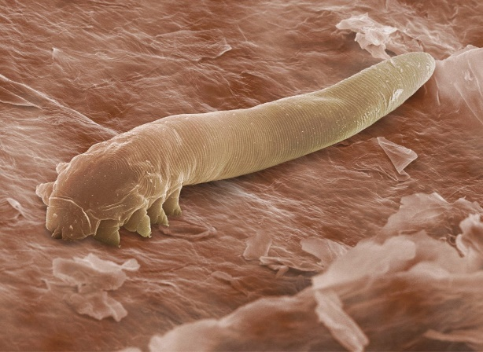
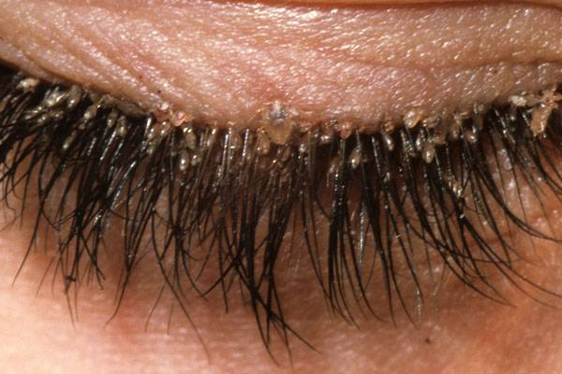
CONFIDENTIAL – ONLY FOR INTERNAL USE
WHAT IS DEMODEX?
DEMODYCOSIS IS A CUTANEOUS DISEASE CAUSED BY A SAPROPHYIC MITE WHICH LIVES, ASYMPTOMATICALLY,
IN EYELASH FOLLICLES
DEMODEX AT PALPEBRAL LEVEL CAN INDUCE VARIOUS CLINICAL SCENARIOS THANKS TO ITS CAPACITIES OF: - INDUCE FOLLICULAR INFLAMMATION WITH OEDEMA - ALTER EYELASHES FORMATION - OBSTRUCTING THE FOLLICULAR FOCUS OF THE MEIBOMIAN AND ZEIS GLANDS REDUCING THE LIPID COMPONENT OF LACRIMAL FILM - ACTING ON MEIBOMIAN GLANDS STRUCTURES
TREATMENTS INDICATIONS ARE SUBJECTED TO LOCAL LAWS RESTRICTIONS

Slide 10
CONFIDENTIAL – ONLY FOR INTERNAL USE
CONSEQUENCES
DESQUAMATION AND ISPISSATION OF PALPEBRAL MARGIN, FRAGILE LASHES, LASHES LOSS, CONJUNCTIVITES, DRY EYE, CHALAZION FORMATION
TREATMENTS INDICATIONS ARE SUBJECTED TO LOCAL LAWS RESTRICTIONS

Slide 11
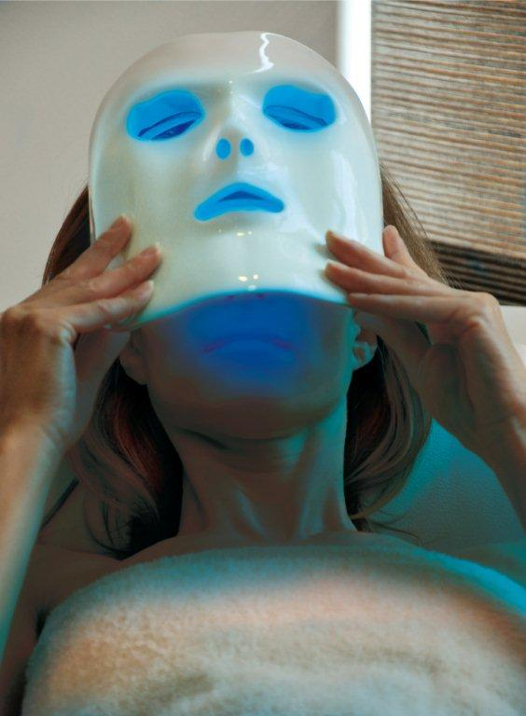
CONFIDENTIAL – ONLY FOR INTERNAL USE
TREATMENT
IT CONSISTS OF A PHASE 1 (WITH A SPECIFIC BLUE LIGHT MASK) AND A PHASE 2 (WITH THE STANDARD SUPPLIED RED LIGHT MASK)
PHASE 1 – BLUE MASK
Blue light stimulates porphyrins and creates an anti-bacterial action.
PHASE 2 – RED MASK →
Red light stimulates ATP by increasing and improving cellular activity, it reduces inflammation and oedema and works on Meibomian glands.
TREATMENTS INDICATIONS ARE SUBJECTED TO LOCAL LAWS RESTRICTIONS

Slide 12
CONFIDENTIAL – ONLY FOR INTERNAL USE
SUGGESTED PROTOCOL
 | Week 1
Blue Mask for 15’ | 2 Applications
Red Mask for 15’ | 2 Applications
In the same session apply first the blue mask for 15 minutes
followed by the red one for 15 minutes more.
TREATMENTS INDICATIONS ARE SUBJECTED TO LOCAL LAWS RESTRICTIONS

Slide 13
CONFIDENTIAL – ONLY FOR INTERNAL USE
BLEPHARITIS
TREATMENTS INDICATIONS ARE SUBJECTED TO LOCAL LAWS RESTRICTIONS

Slide 14
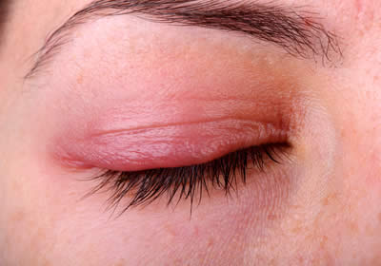
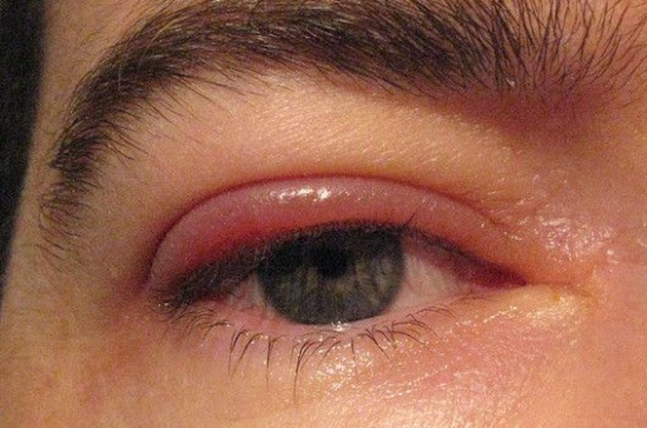
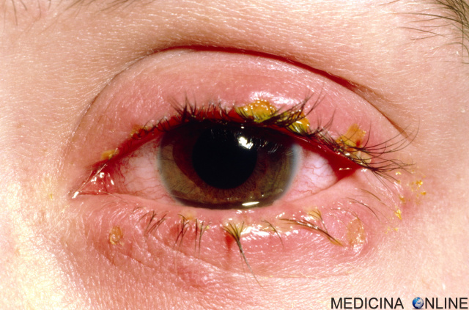
CONFIDENTIAL – ONLY FOR INTERNAL USE
WHAT IS BLEPHARITIS?
IT IS AN ACUTE OR CHRONIC INFLAMMATION OF THE FREE PALPEBRAL MARGIN. SIGNS AND SYMPTOMS INCLUDE ITCHING AND BURNING ASSOCIATED WITH HYPERAEMIA AND OEDEMA
IT COULD BE:
- ULCERATIVE ACUTE; GENERALLY CAUSED BY A BACTERIAL INFECTION (CAN HAVE A VIRAL ETIOLOGY) - NON-ULCERATIVE ACUTE; IT IS SOLELY THE CONSEQUENCE OF A LOCAL ALLERGIC REACTION -CHRONIC; NON-INFECTIVE INFLAMMATION WITH IDIOPATICS ETIOLOGY.
TREATMENTS INDICATIONS ARE SUBJECTED TO LOCAL LAWS RESTRICTIONS

Slide 15
CONFIDENTIAL – ONLY FOR INTERNAL USE
CONSEQUENCES
ITCHING AND BURNING OF THE FREE PALPEBRAL MARGIN, CONJUNCTIVAL IRRITATION WITH LACRIMATION, PHOTOPHOBIA AND FOREIGN BODY SENSATION
TREATMENTS INDICATIONS ARE SUBJECTED TO LOCAL LAWS RESTRICTIONS

Slide 16
CONFIDENTIAL – ONLY FOR INTERNAL USE
TREATMENT
IT CONSISTS OF A PHASE 1 (WITH A SPECIFIC BLUE LIGHT MASK) AND A PHASE 2 (WITH THE STANDARD SUPPLIED RED LIGHT MASK)
PHASE 1 – BLUE MASK
Blue light stimulates porphyrins and create an anti-bacterial action.
PHASE 2 – RED MASK →
Red light stimulates ATP by increasing and improving cellular activity, it reduces inflammation and oedema and works on Meibomian glands.
TREATMENTS INDICATIONS ARE SUBJECTED TO LOCAL LAWS RESTRICTIONS

Slide 17
CONFIDENTIAL – ONLY FOR INTERNAL USE
SUGGESTED PROTOCOL
ULCERATIVE ACUTE
 | Week 1 | Week 2
Blue Mask for 15’ | 2 Applications | 2 Applications
Red Mask for 15’ | 2 Applications | 2 Applications
In the same session apply first the blue mask for 15 minutes
followed by the red one for 15 minutes more.
TREATMENTS INDICATIONS ARE SUBJECTED TO LOCAL LAWS RESTRICTIONS

Slide 18
CONFIDENTIAL – ONLY FOR INTERNAL USE
SUGGESTED PROTOCOL
NON-ULCERATIVE ACUTE
 | Week 1 | Week 2
Red Mask for 15’ | 2 Applications | 2 Applications
TREATMENTS INDICATIONS ARE SUBJECTED TO LOCAL LAWS RESTRICTIONS

Slide 19
CONFIDENTIAL – ONLY FOR INTERNAL USE
SUGGESTED PROTOCOL
CHRONIC
 | Week 1 | Week 2 | Week 3
Red Mask for 15’ | 2 Applications | 2 Applications | 2 Applications
TREATMENTS INDICATIONS ARE SUBJECTED TO LOCAL LAWS RESTRICTIONS

Slide 20
CONFIDENTIAL – ONLY FOR INTERNAL USE
CHALAZION
TREATMENTS INDICATIONS ARE SUBJECTED TO LOCAL LAWS RESTRICTIONS

Slide 21
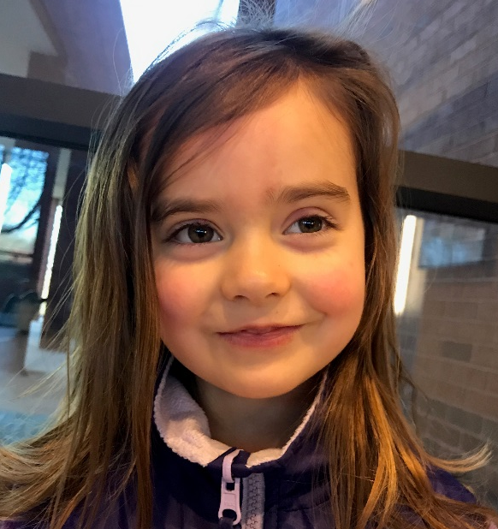
CONFIDENTIAL – ONLY FOR INTERNAL USE
WHAT IS CHALAZION?
IT IS CAUSED BY THE NON-INFECTIVE BASIS OBSTRUCTION OF A MEIBOMIAN GLAND. THE OBSTRUCTION PRODUCES A BUILD-UP OF IRRITATING LIPIDIC COMPOUNDS IN SORROUNDING LID TISSUES WITH CONSEQUENT INFLAMMATION
BEFORE
AFTER 1 TREATMENT
TREATMENTS INDICATIONS ARE SUBJECTED TO LOCAL LAWS RESTRICTIONS

Slide 22
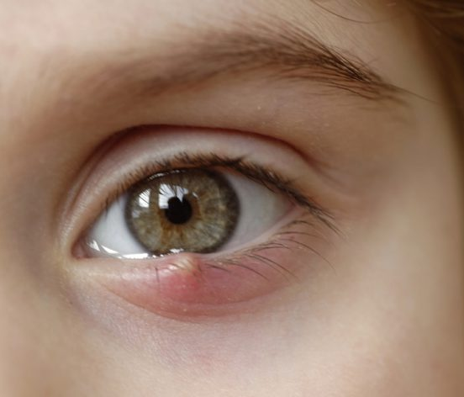
CONFIDENTIAL – ONLY FOR INTERNAL USE
CONSEQUENCES
THE LID FIRST APPEARS TUMIFIED, AFTER 1 OR 2 DAYS THE CHALAZION MOVES IN THE BODY OF THE LID FORMING A NON PAINFUL LUMP. ACCORDING TO THE DIMENSION AND POSITION, A CHALAZION CAN DAMAGE THE CORNEA CAUSING A SLIGHTLY DISPLACED VISION
TREATMENTS INDICATIONS ARE SUBJECTED TO LOCAL LAWS RESTRICTIONS

Slide 23
CONFIDENTIAL – ONLY FOR INTERNAL USE
TREATMENT
IT CONSISTS OF AN APPLICATION
WITH THE STANDARD SUPPLY RED LIGHT MASK
RED MASK →
Red light stimulates ATP by increasing and improving cellular activity, it reduces inflammation and oedema and works on Meibomian glands.
TREATMENTS INDICATIONS ARE SUBJECTED TO LOCAL LAWS RESTRICTIONS

Slide 24
CONFIDENTIAL – ONLY FOR INTERNAL USE
SUGGESTED PROTOCOL
 | Week 1
Red Mask for 15’ | 2 Applications
TREATMENTS INDICATIONS ARE SUBJECTED TO LOCAL LAWS RESTRICTIONS

Slide 25
CONFIDENTIAL – ONLY FOR INTERNAL USE
STYE
TREATMENTS INDICATIONS ARE SUBJECTED TO LOCAL LAWS RESTRICTIONS

Slide 26
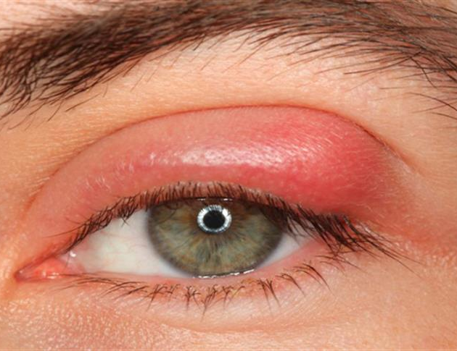
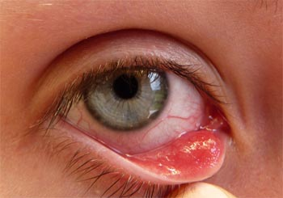
CONFIDENTIAL – ONLY FOR INTERNAL USE
WHAT IS A STYE?
IT IS CAUSED BY THE OBSTRUCTION OF A CILIARY FOLLICLE AND OF THE ZEISS OR MOLL GLANDS CONNECTED TO THE FOLLICLE.
THIS CAUSES AN INFECTION.
TREATMENTS INDICATIONS ARE SUBJECTED TO LOCAL LAWS RESTRICTIONS

Slide 27
CONFIDENTIAL – ONLY FOR INTERNAL USE
CONSEQUENCES
IT IS CHARACTERIZED AS A LOCALIZED SWELLING OF THE INTERNAL OR EXTERNAL EYELID. AFTER 1 OR 2 DAYS THE EXTERNAL STYE SHOWS ON THE LID MARGIN. GENERALLY A SMALL BOIL IS VISIBLE CLOSE TO THE LASH ROOT, SURROUNDED BY HYPEREMIA, SWELLING AND OEDEMA.
IN 2/4 DAYS THE LESION FISTULATES WITH SECRETIONS.
TREATMENTS INDICATIONS ARE SUBJECTED TO LOCAL LAWS RESTRICTIONS

Slide 28
CONFIDENTIAL – ONLY FOR INTERNAL USE
TREATMENT
IT CONSISTS OF AN APPLICATION
WITH THE STANDARD SUPPLIED RED LIGHT MASK
PHASE 2 – RED MASK →
Red light stimulates ATP by increasing and improving cellular activity, it reduces inflammation and edema and works on Meibomian glands.
TREATMENTS INDICATIONS ARE SUBJECTED TO LOCAL LAWS RESTRICTIONS

Slide 29
CONFIDENTIAL – ONLY FOR INTERNAL USE
SUGGESTED PROTOCOL
 | Week 1
Red Mask for 15’ | 2 Applications
TREATMENTS INDICATIONS ARE SUBJECTED TO LOCAL LAWS RESTRICTIONS

Slide 30
CONFIDENTIAL – ONLY FOR INTERNAL USE
CLARIFICATIONS
TREATMENTS INDICATIONS ARE SUBJECTED TO LOCAL LAWS RESTRICTIONS

Slide 31
CONFIDENTIAL – ONLY FOR INTERNAL USE
POST-BLEPHAROPLASTY
Only LLLT® MASK - yellow + red
NO IPL
TREATMENTS INDICATIONS ARE SUBJECTED TO LOCAL LAWS RESTRICTIONS

Slide 32
CONFIDENTIAL – ONLY FOR INTERNAL USE
DEMODEX
DEMODEX is always linked to dry eye problems, so you perform IPL + LLLT treatment and, in addition,
if this is not conclusive for DEMODEX, the protocol indicated will be:
PHASE 1 - blue mask with antibacterial effect
+
PHASE 2 - red mask for anti-inflammatory activity
TREATMENTS INDICATIONS ARE SUBJECTED TO LOCAL LAWS RESTRICTIONS

Slide 33
CONFIDENTIAL – ONLY FOR INTERNAL USE
BLEPHARITIS
Perform the complete treatment for MGD, IPL + LLLT,
subsequently, if not resolved, proceed with the indicated protocol:
PHASE 1 - blue mask with antibacterial effect
+
PHASE 2 - red mask for anti-inflammatory activity
taking care to respect the 3 types of blepharitis indicated in the protocol
TREATMENTS INDICATIONS ARE SUBJECTED TO LOCAL LAWS RESTRICTIONS

Slide 34
CONFIDENTIAL – ONLY FOR INTERNAL USE
CHALAZION
For its nature, it does not allow a high thermal impact and therefore IPL is not to be used.
You have to use only the LLLT red mask as per protocol.
TREATMENTS INDICATIONS ARE SUBJECTED TO LOCAL LAWS RESTRICTIONS

Slide 35
CONFIDENTIAL – ONLY FOR INTERNAL USE
STYE
The treatment of Stye is similar to Chalazion treatment,
so only the LLLT red mask is to be used
TREATMENTS INDICATIONS ARE SUBJECTED TO LOCAL LAWS RESTRICTIONS

